Slide 1
初階影像處理、嵌入式機器人視覺 及人機互動 (Introduction to Image Processing, Embedded Robot Vision and Human-Computer Interaction) Homework 1
TA:
Edward: thanhng1985@gmail.com
Charlie: p76074664@mail.ncku.edu.tw
Office Hour: 15:00~17:00, Mon. 20:00~22:00, Tue.
At CSIE 9F Robotics Lab.

Slide 2
Notice (1/2)
No Plagiarism!! If you plagiarize, you will get 0.
If TA can’t compile and run your homework. Within one week, come to our Lab (65904) and present (demo) your homework. (or your score will be zero)
Deadline => 2018/10/15 (Mon.) 23:59:59 2018/10/18(Thu) 23:59:59
No delay. If you submit homework after deadline, you will get 0.
Upload to => 140.116.154.1 -> Upload/Homework/OpenCv_Hw1
Account: opencv2018
Password: opencv2018
Format:
Filename:
Hw1_Student ID_Name_Version.rar, ex: Hw1_F71234567_林小明_v1.rar
If you want to update your file, change ver., ex: Hw1_F71234567_林小明_v2.rar
Content: whole project (including images), (Please delete the debug file)

Slide 3
Notices (2/2)
C++ (check MFC guide in ftp)
OpenCV 3.3.1 (https://opencv.org/release.html)
Visual Studio 2015 (download from http://www.cc.ncku.edu.tw/download/)
UI framework: MFC
Python (check pyqty guide om ftp)
opencv-python (3.4.3.18)
Python 3.6.5 (https://www.python.org/downloads/)
UI framework: pyqt5 (5.11.3)

Slide 4
Assignment scoring (Total: 100%)
0. GUI
1. (20%) Image Processing (出題：Tri, Helen, Ann, Ford, Phu)
1.1 Load Image File (5%)
1.2 Color Conversion (5%)
1.3 Image Flipping (5%)
1.4 Blending (5%)
2. (20%) Edge Detection (出題：Ben, Carol)
3. (20%) The Gaussian and Laplacian Pyramids (出題：Erin, Daniel, Oscar)
4. (20%) Adaptive Threshold (出題：Edward, Jenny)
4.1 Global Threshold (10%)
4.2 Local Threshold (10%)
5. (20%) Image Transformation (出題：Tri, Helen)
5.1 Rotation, scaling, translation (10%)
5.2 Perspective transform (10%)

Slide 5
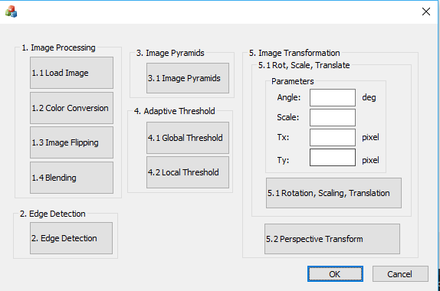
0. GUI
Use MFC to create GUI like following picture.

Slide 6
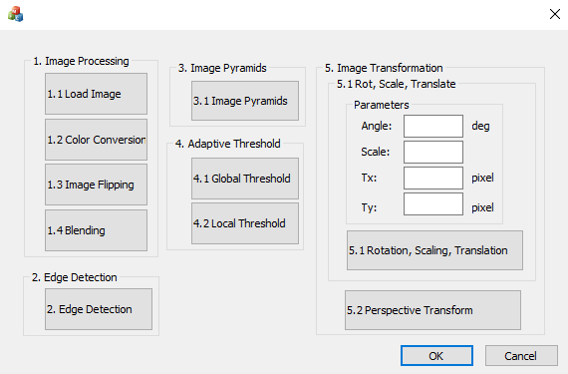
1. (20%) Image Processing (出題： Tri, Helen, Ann, Ford, Phu)
1.1 Load Image File (5%)
1.2 Color Conversion (5%)
1.3 Image Flipping (5%)
1.4 Blending (5%)

Slide 7
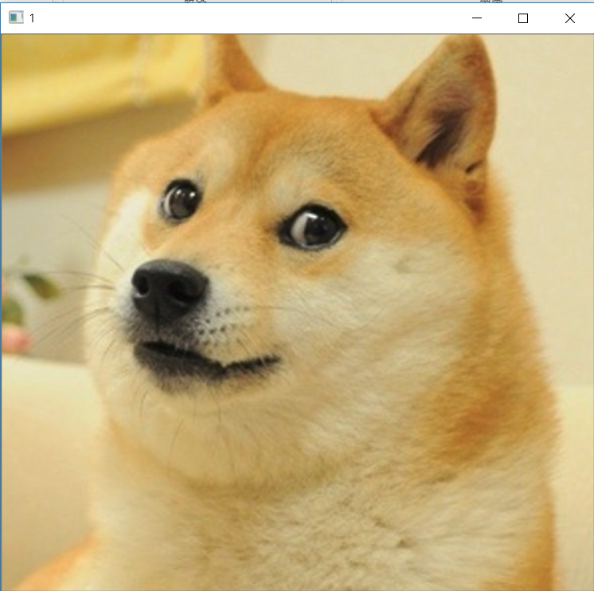
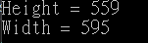
1.1 Load Image File (5%)
Given: dog.bmp image
Q: 1) Open a new window to show the image (dog.bmp)
2) Show the height and width of the image in console mode
Hint : Textbook Chapter 2, p. 22~23

Slide 8
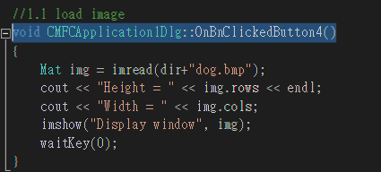
1.1 Load Image File (5%): Answer (Gimmy)
Given: dog.bmp image
Q: 1) Open a new window to show the image (dog.bmp)
2) Show the height and width of the image in console mode
Answer: Mat imread(const string& filename, int flags=IMREAD_COLOR )
(1) filename – Name of file to be loaded.
(2) flags – Flags specifying the color type of a loaded image:
CV_LOAD_IMAGE_ANYDEPTH
CV_LOAD_IMAGE_COLOR
CV_LOAD_IMAGE_GRAYSCALE

Slide 9
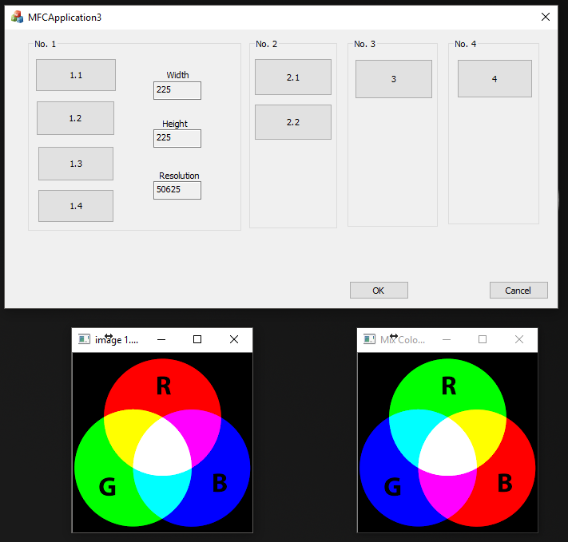
1.2 Color Conversion (5%)
Given: a color image, “color.png”
Q: 1) Exchange 3 channels of the image BGR to RBG 2) Open a new window to show the result.
Example：BGR value of pixel P is P(a,b,c), the value of pixel P will be P(b,c,a) after changing.
Hint: Textbook Chapter 3, p.31 ~ p.44

Slide 10
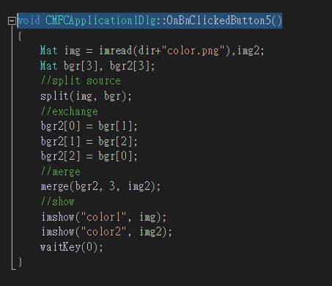
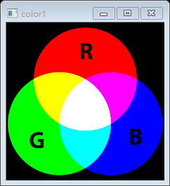
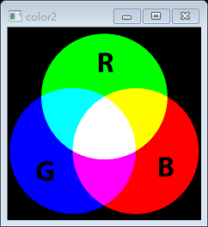
1.2 Color Conversion (5%): Answer (Gimmy)
Given: a color image, “color.png”
Q: 1) Exchange 3 channels of the image BGR to RBG 2) Open a new window to show the result.
Answer：(1) void split(InputArray m, OutputArrayOfArrays mv)
(2) void merge(InputArrayOfArrays mv, OutputArray dst)
src – input multi-channel array(BGR)
mv – output array or vector of arrays(RBG)
Input
Output

Slide 11
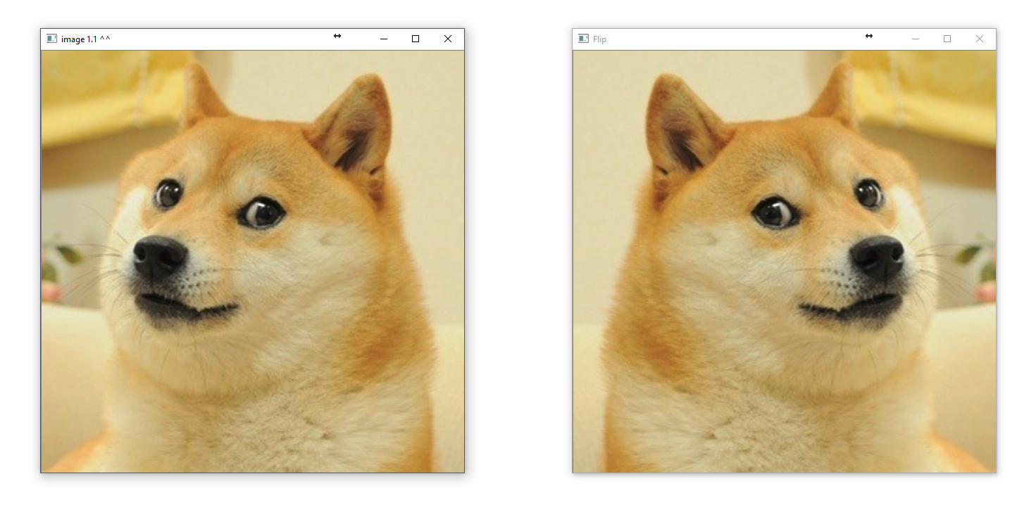
1.3 Image Flipping (5%)
Given: an image, dog.bmp
Q: 1) Flip the image (dog.bmp) and open a new window to show the result.
Hint: Textbook Chapter 3, p.31 ~ p.44

Slide 12
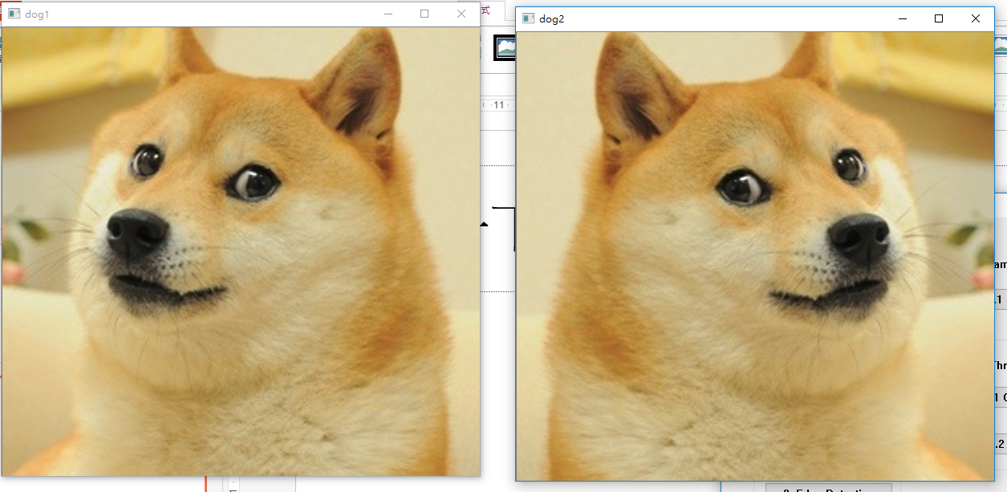
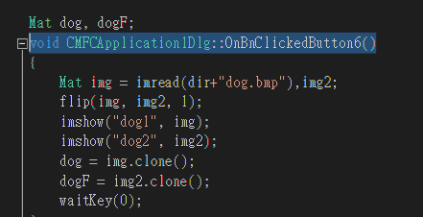
1.3 Image Flipping (5%): Answer (Gimmy)
Given: an image, dog.bmp
Q: 1) Flip the image (dog.bmp) and open a new window to show the result.
Answer: (1) void flip(InputArray src, OutputArray dst, int flipCode)
(2) Mat Mat::clone()
0 : flipping around the x-axis
positive value (for example, 1) : flipping around y-axis
Negative value (for example, -1) : flipping around both axes

Slide 13
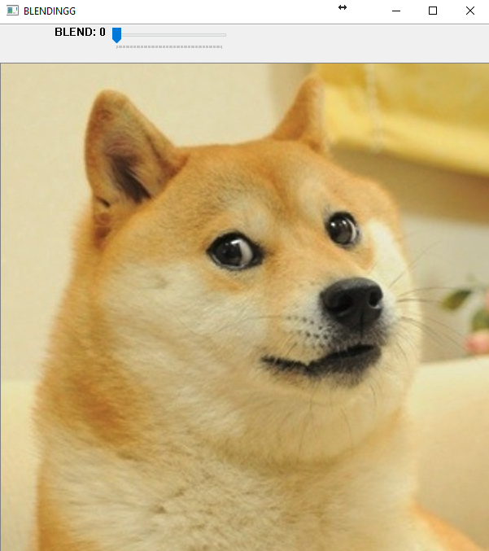

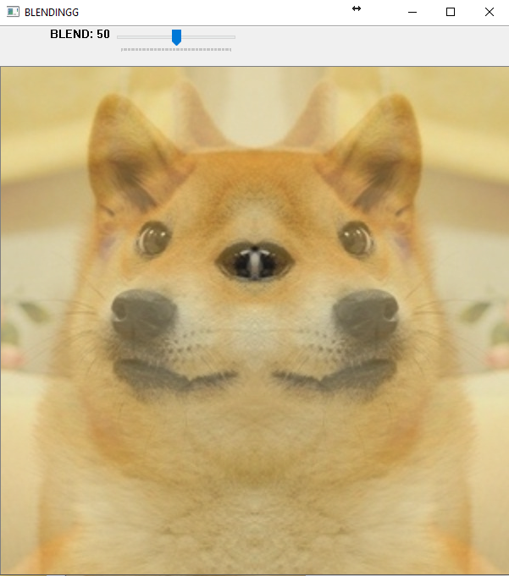
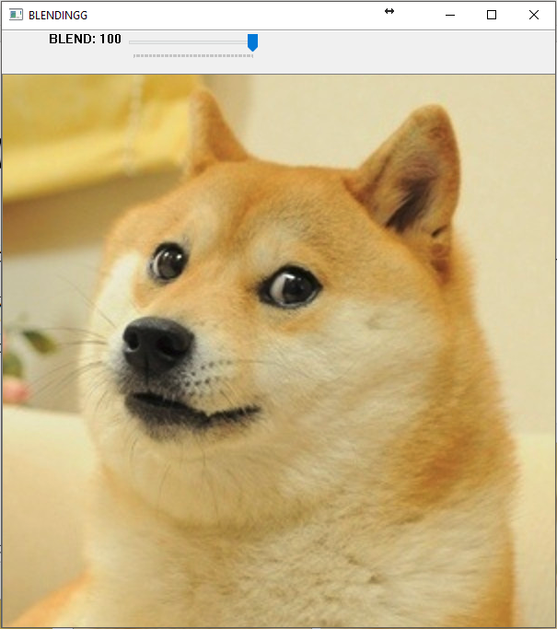
1.4 Blending (5%)
Given: 2 images, dog.bmp and the result of 1.3
Q: 1) Combine two images (dog.bmp and the result of 1.3). 2) Use Trackbar to change the weighting and show the result in the new window.
Hint:
Textbook Chapter 3, p. 51 ~ 51
createTrackbar(...);

Slide 14
1.4 Blending (5%): Answer (Gimmy)
Given: 2 images, dog.bmp and the result of 1.3
Q: 1) Combine two images (dog.bmp and the result of 1.3). 2) Use Trackbar to change the weighting and show the result in the new window.
Answer:
(1) int createTrackbar(const string& trackbarname, const string& winname, int* value, int count, TrackbarCallback onChange=0, void* userdata=0)
(2) void setTrackbarPos(const string& trackbarname, const string& winname, int pos)
(3) void addWeighted(InputArray src1, double alpha, InputArray src2, double beta, double gamma, OutputArray dst, int dtype=-1)

Slide 15
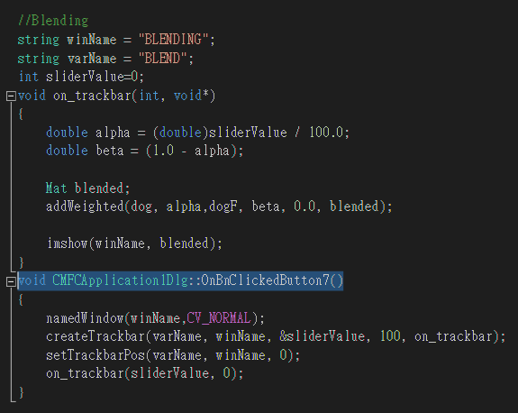
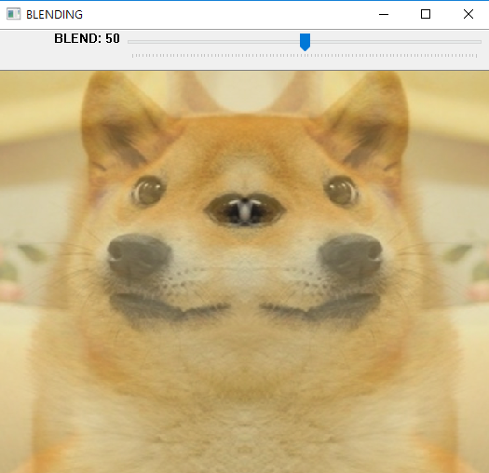
1.4 Blending (5%): Answer (Gimmy)
Given: 2 images, dog.bmp and the result of 1.3
Q: 1) Combine two images (dog.bmp and the result of 1.3). 2) Use Trackbar to change the weighting and show the result in the new window.
Answer:

Slide 16
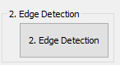
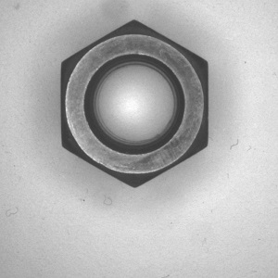
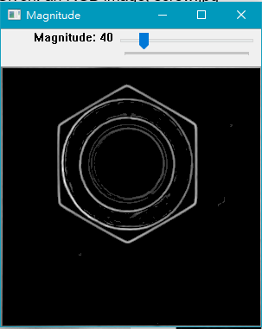
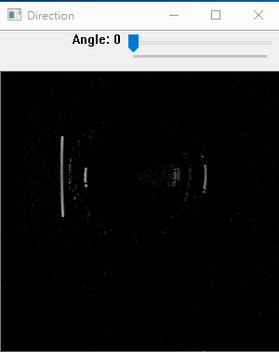
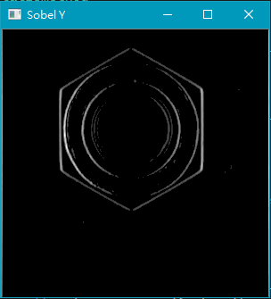
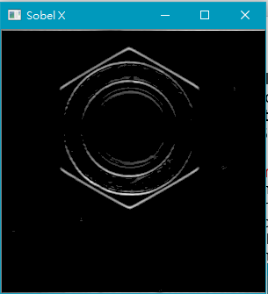
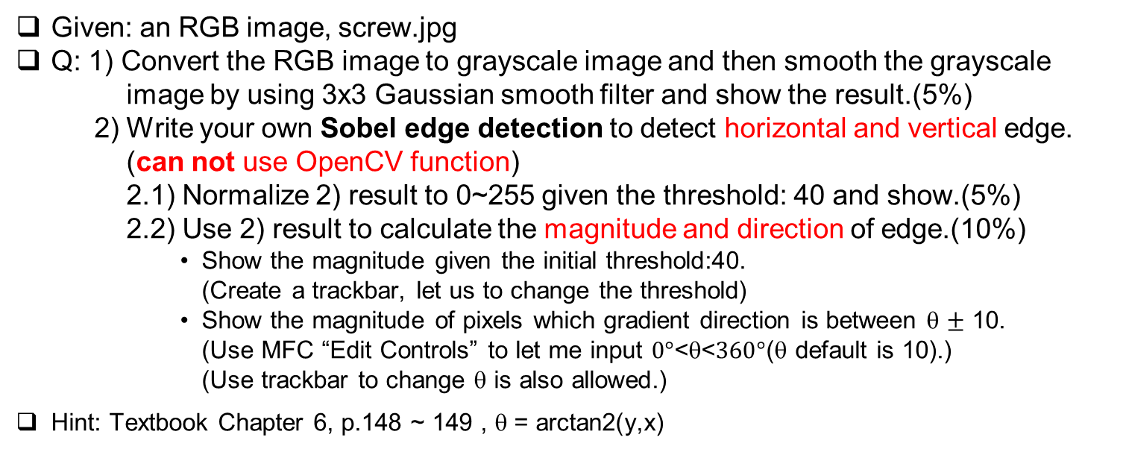
2. Edge Detection (20%) (出題：Ben, Carol)
Given: an RGB image, screw.jpg
Q: 1) Convert the RGB image to grayscale image and then smooth the grayscale image by using 3x3 Gaussian smooth filter and show the result.(5%)
2) Write your own Sobel edge detection to detect horizontal and vertical edge.
(can not use OpenCV function)
2.1) Normalize 2) result to 0~255 given the threshold: 40 and show.(5%)
2.2) Use 2) result to calculate the magnitude and direction of edge.(10%)
Show the magnitude given the initial threshold:40. (Create a trackbar, let us to change the threshold)
Show the magnitude of pixels which gradient direction is between θ $±$ 10. (Use MFC “Edit Controls” to let me input $0°$<θ<$360°$(θ default is 10).) (Use trackbar to change θ is also allowed.)
Hint: Textbook Chapter 6, p.148 ~ 149 , θ = arctan2(y,x)
vertical edges
magnitude
direction
Horizontal edges
screw.jpg
(GIF)

Slide 17
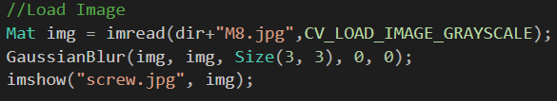
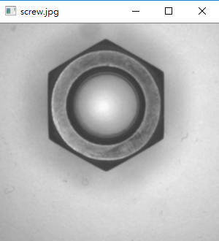
2.1 Convert to grayscale image & smooth (Shaku)
GaussianBlur(src,dst,kernel,sigma_x,sigma_y)
Sigma_x/y : set to 0 will use the default deviation base on kernel size (if 3x3 ,sigma=0.8)

Slide 18
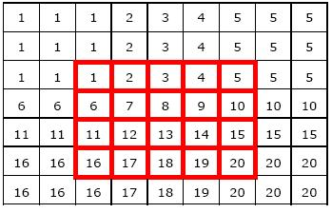
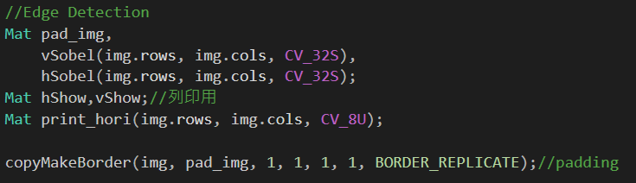
2.2 Write your own Sobel edge detection (Shaku)
copyMakeBorder
BORDER_REPLICATE (recommended)

Slide 19
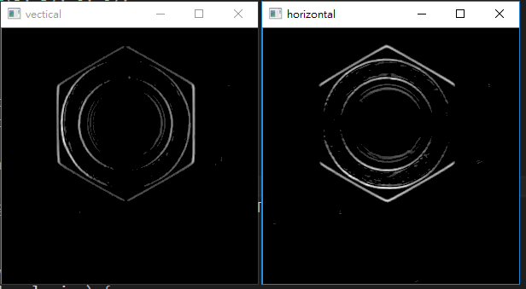
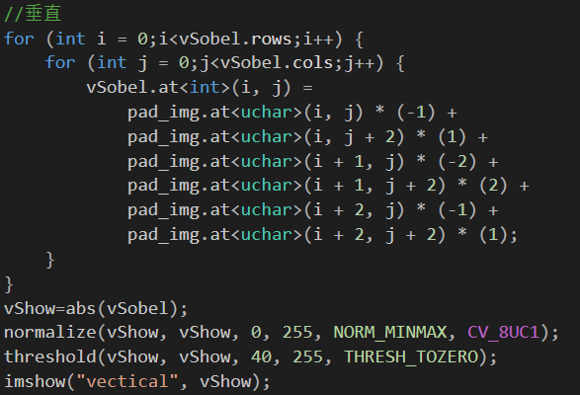
2.2 Write your own Sobel edge detection (Shaku)

Slide 20
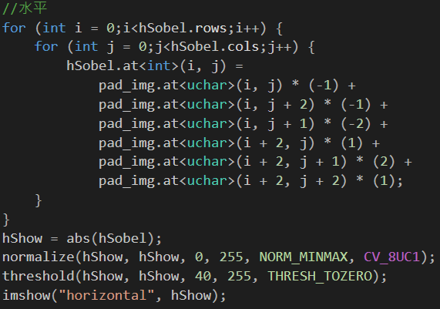
2.2 Write your own Sobel edge detection (Shaku)

Slide 21
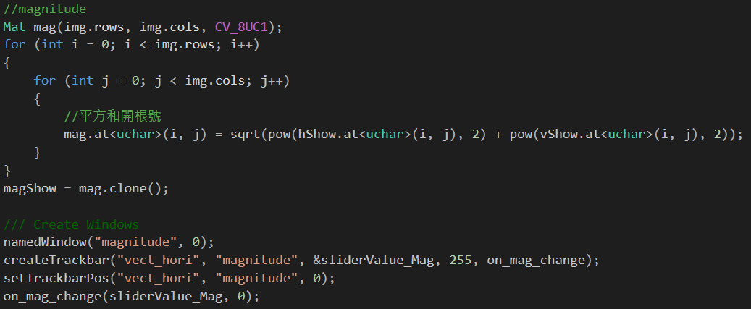
2.3 Magnitude (Shaku)

Slide 22
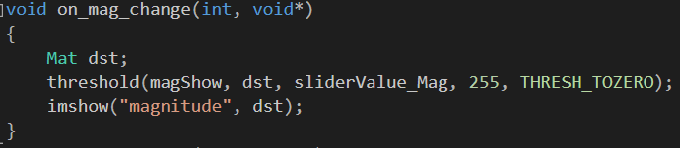
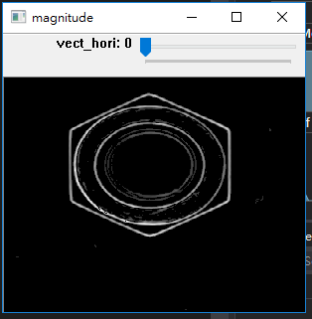
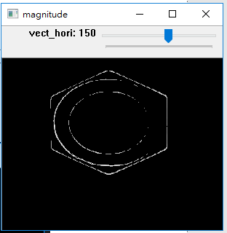
2.3 Magnitude (Shaku)
sliderValue_Mag : min magnitude value (init 0)

Slide 23
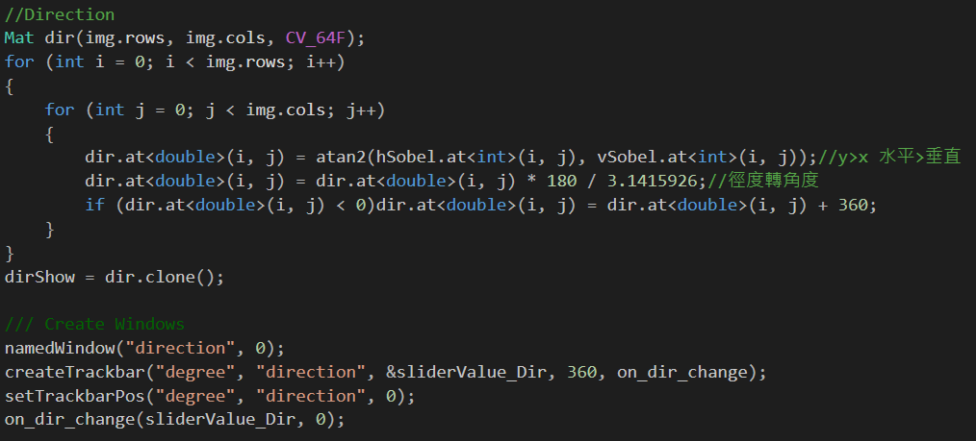
2.3 Direction (Shaku)

Slide 24
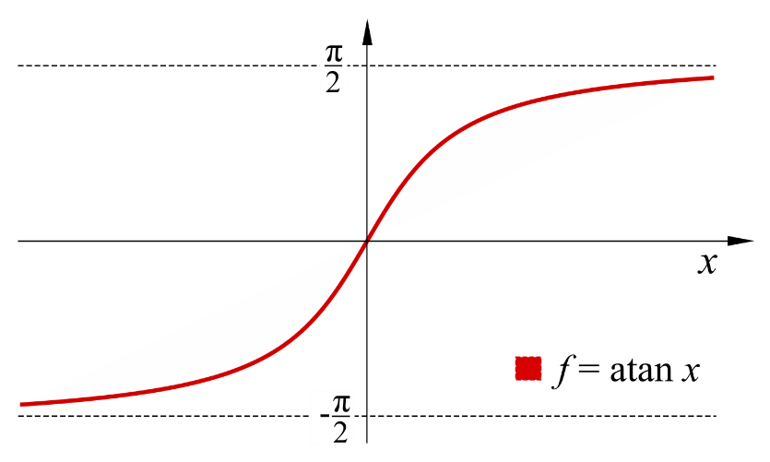
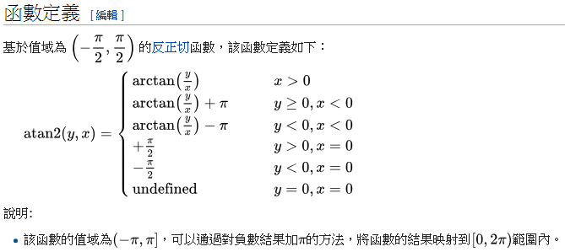
2.3 Direction (Shaku)

Slide 25
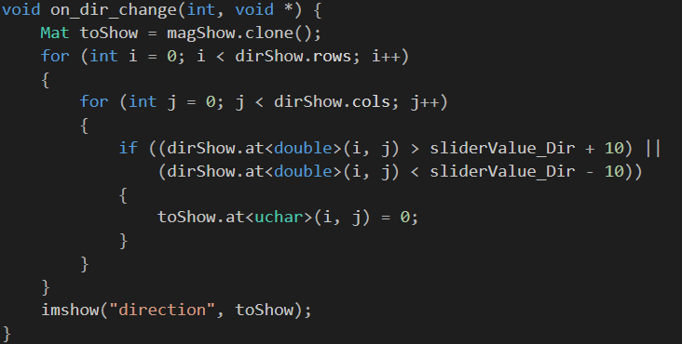
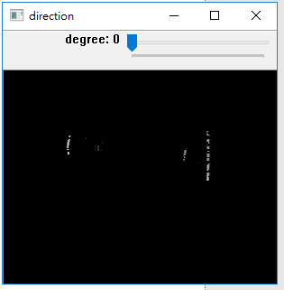
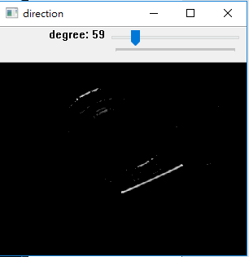
2.3 Direction (Shaku)
sliderValue_Dir : direction (init 0)

Slide 26
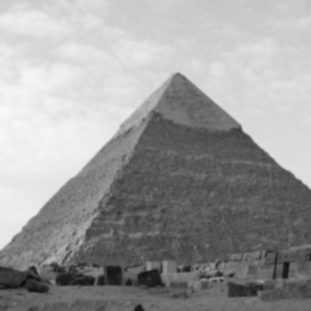
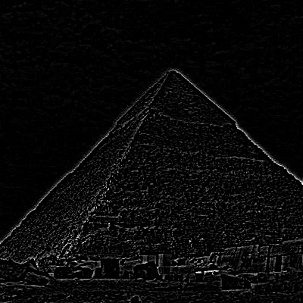
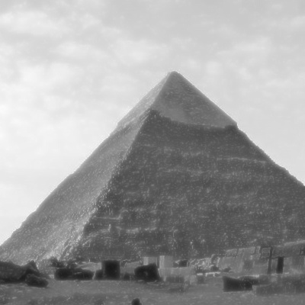


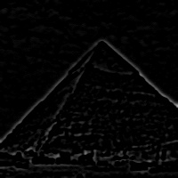



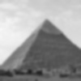

3. The Gaussian and Laplacian pyramids (20%) (出題：Erin, Daniel, Oscar)
Given: an image, pyramids_Gray.jpg
Q: show Gaussian and Laplacian pyramids, also show the inverse process images for recovering the original image from the subimages.
1) Show Gaussian pyramid level 1 image (5%)
2) Show Laplacian pyramid level 0 image (5%)
3) Show Inverse pyramid level 1 image (5%)
4) Show Inverse pyramid level 0 image (5%)
Hint: OpenCV textbook chapter 5，p.130~132, GAUSSIAN_5x5 =
Gaussian pyramid
Laplacian pyramid
Inverse pyramid
level 0
level 1
level 2

Slide 27

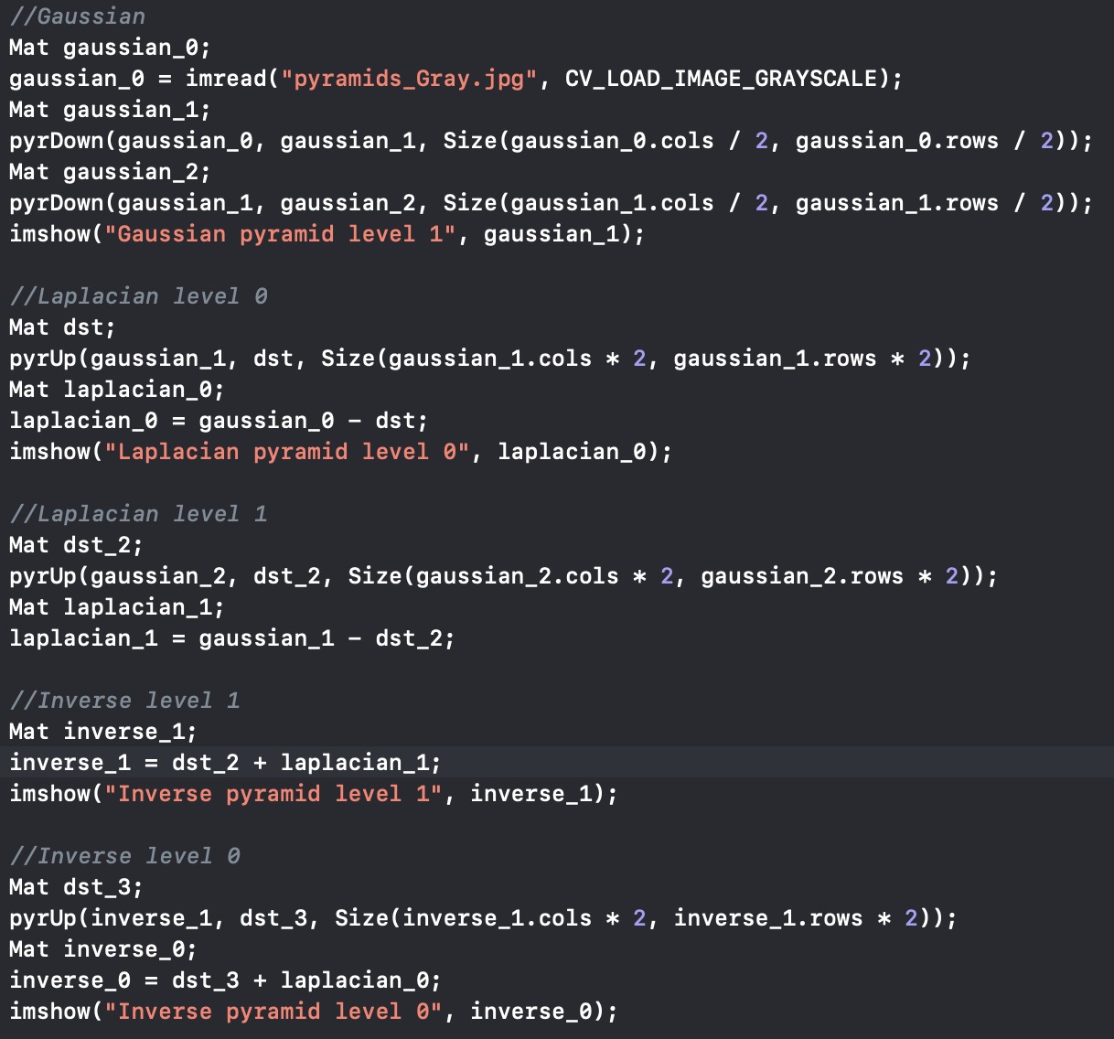
3. The Gaussian and Laplacian pyramids: Answer (Yi Yuan)
Function:
1) pyrDown( src, dst, Size( src.cols/2, src.rows/2 ))
2) pyrUp( src, dst, Size( src.cols*2, src.rows*2 ))
src: The current image
dst: The destination
Size( src.cols*2, src.rows*2 ): The destination size
Gaussian

Slide 28
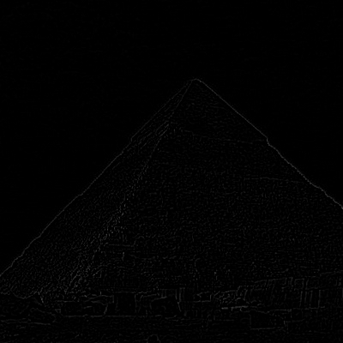


3. The Gaussian and Laplacian pyramids: Answer (Yi Yuan)
Laplacian
Inverse

Slide 29
4. (20%) Adaptive Threshold (出題: Edward, Jenny)
4.1 Global Threshold (10%) 4.2 Local Threshold (10%)

Slide 30
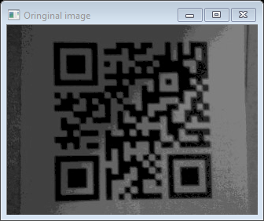
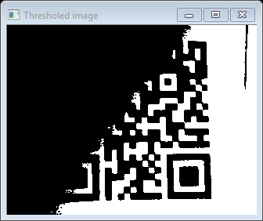
4.1 Global Threshold (10%)
Given: a non-uniformly illuminated QR.png
Q: 1) Show original image
2) Show the result after applying global threshold
Hint:
OpenCV Textbook Chapter 5 (p.136~138)
threshold(args) func with threshold value = 80
QR.png
global threshold

Slide 31


4.1 Global Threshold (10%): Answer (Michael)
Given: a non-uniformly illuminated QR.png
Q: 1) Show original image
2) Show the result after applying global threshold
Official documents:
Solution:

Slide 32

4.2 Local Threshold (10%)
Given: a non-uniformly illuminated QR.png
Q: 1) Show original image
2) Show the result after applying local threshold
Hint:
OpenCV Textbook Chapter 5 (p.136~138)
adaptiveThreshold(args) func with blockSize = 19, offset = -1
QR.png
local threshold

Slide 33


4.2 Local Threshold (10%): Answer (Michael)
Given: a non-uniformly illuminated QR.png
Q: 1) Show original image
2) Show the result after applying local threshold
Solution:

Slide 34


5.1 (10%) Transforms: Rotation, Scaling, Translation (出題：Tri, Helen, Ann)
Given: OriginalTransform.png image
Q: 1) Click button “5.1”, OriginalTransform.png should be showed.
2) Please rotate, scale and translate the small squared image (as Figure 3.1) with following parameters (should be entered in the GUI (using Edit Control)):
(1) Angle = 45⁰ (counter-clockwise)
(2) Scale = 0.8,
(3) Translation with:
x_{new} = x_{old} + 150 (Tx) pixels = 130 + 150 = 280
y_{new} = y_{old} + 50 (Ty) pixels = 125 + 50 = 175
Point C (130,125) is center of small square image
Hint: OpenCV Textbook Chapter 12 (p. 407 ~ p. 412, warpAffine(…);
EX:
Small square image
C (130,125)
C (280,175)
45⁰
Figure 3.1 Original Image
Figure 3.2 Rotation, Scale and Translation Image

Slide 35


5.1 (10%) Transforms: Rotation, Scaling, Translation Answer (Rex)
1 0 tx
0 1 ty

Slide 36


5.2 (10%) Perspective Transformation (出題：Tri, Helen, Ann)
Given: OriginalPerspective.png image
Q: Use OpenCV functions to straighten the image
1) Click button “5.2” to show image in the new window. Then do:
Click 4 points showed in console window. (start from top-left corner of the original image, and then click clock-wise)
Warp the original image to the location (20,20), (20,450), (450,450), (450,20). Open second window to show the result.
Hint:
Textbook Chapter 6
mouse callback function(p.96)
(20,20)
(450,20)
(20,20)
y
1
2
x
4
3
Original Perspective
(20,450)
Perspective Image
(450,450)

Slide 37

5.2 (10%) Perspective Transformation: Answer (Rex)

Slide 38

5.2 (10%) Perspective Transformation: Answer (Rex)

Slide 39

5.2 (10%) Perspective Transformation: Answer (Rex)

